Slide 1
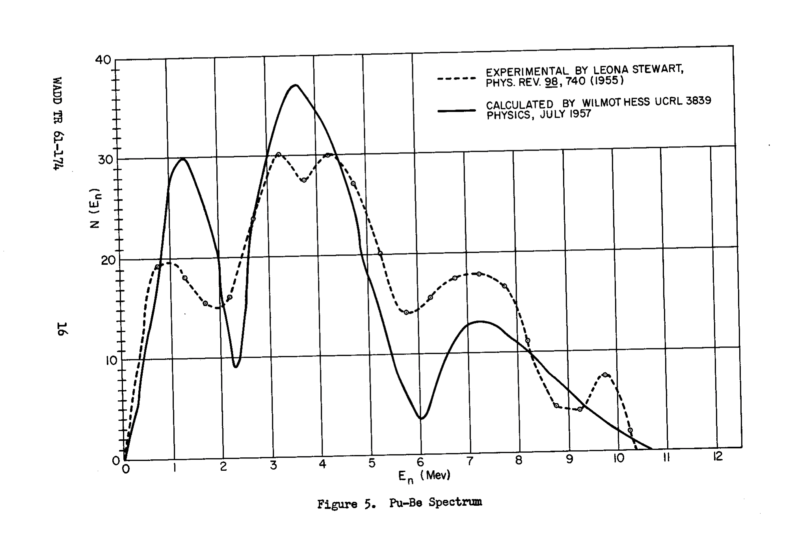

Slide 2
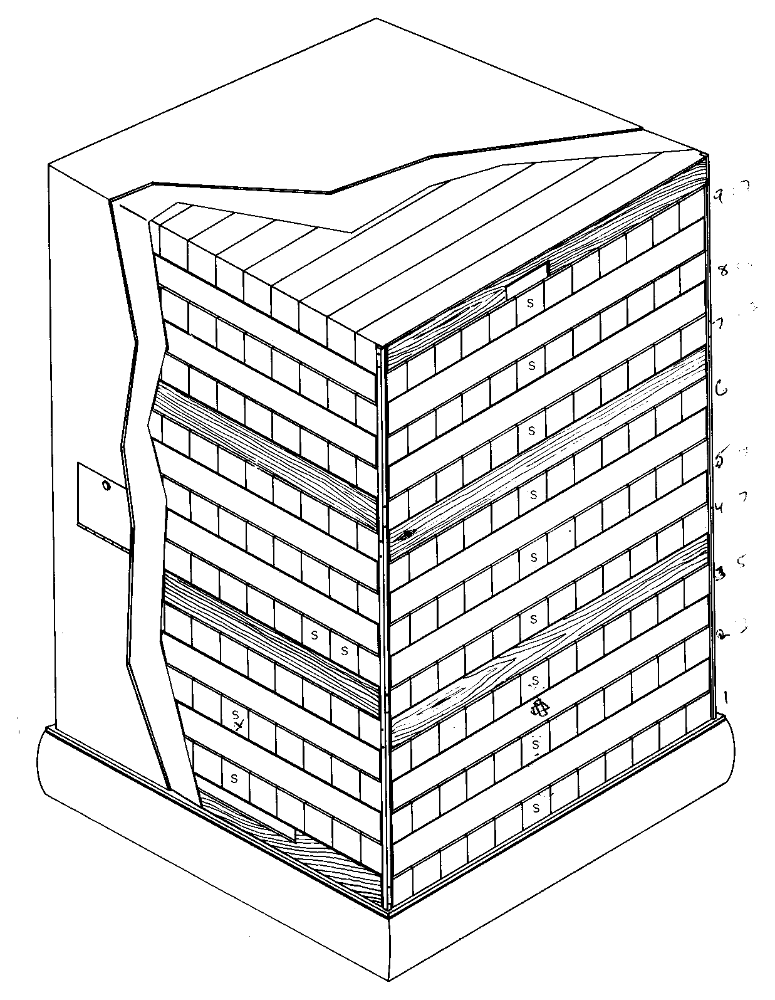
S9
S8
S7
S6
S12
S5
S4
S11
S3
S
S2
S10
S1

